Slide 1
Chapter: 6.4
Three types of intermolecular forces

Slide 2
There are three types of intermolecular forces.
Dispersion forces, dipole-dipole forces and hydrogen bonds.
Intermolecular forces occur between molecules of the same substance and between molecules of different substances.
Intermolecular forces are much weaker than the intramolecular forces that exist within molecules. Intramolecular forces are generally considered to be covalent. Covalent, ionic and metallic bonding are much stronger than the intermolecular forces.

Slide 3
The strength of intermolecular forces increases with increasing polarisation of molecules. The weakest is the dispersion force, then the dipole-dipole force and then a special case of the dipole-dipole force, the hydrogen bond.

Slide 4
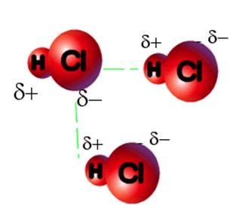
Dipole-dipole forces
In polar molecules, there is a net dipole. One end of molecule is slightly negative while the other end is slightly positive. Hydrochloric acid (HCl) is a polar molecule. The presence of dipoles creates an attraction between neighbouring molecules, a dipole-dipole force, which is an attraction between two dipoles in two individual molecules .

Slide 5
Molecules line up so that the slightly positive ( δ+) end of one molecule attracts the slightly negative end (δ-) of another molecule. The dipole-dipole attraction/ force is relatively strong because the dipole is permanent.

Slide 6
Hydrogen bonds
The dipole-dipole force occurs when there is a permanent dipole present. The hydrogen bond is a special case of the dipole-dipole force.
https://www.youtube.com/watch?v=aH2IbYs_XjY
https://www.youtube.com/watch?v=ZWqC1uDNlJ0
A hydrogen bond occurs when a H atom that is bonded to an O, N, F atom in one molecule becomes attracted to the lone pair of electrons of N, O or F of an adjacent molecule.
The following diagram in the next slide shows a general increase in boiling points as you go down the periodic table groups, excluding period-2 hydrides.

Slide 7
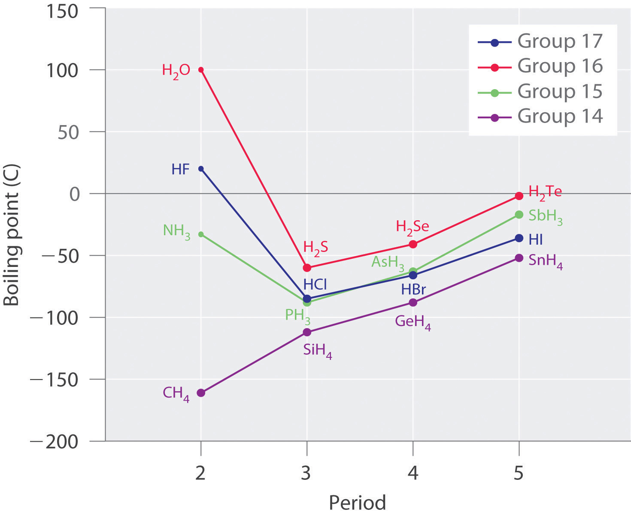
Boiling point of hydrides of groups 14-17

Slide 8
Boiling and melting points give an estimation of the strength of intermolecular forces between molecules.
When nitrogen, oxygen or fluorine is attached to a hydrogen atom, the resulting molecule has an unusually high boiling point. A special dipole-dipole force occurs called a hydrogen bond formed when these very electronegative elements bond to hydrogen. This is the strongest of the weak intermolecular forces about one-tenth the strength of a covalent bond. In diagrams, it is shown as a dotted line between the molecules.

Slide 9
Hydrogen bonds are due to the hydrogen nucleus being extremely small. When hydrogen is bonded to the most electronegative elements ( fluorine, oxygen and nitrogen), the charge over the polar covalent bond is at a maximum.
Water displays hydrogen bonding. Oxygen’s strong electronegativity means electrons in the O-H covalent bond are more attracted to oxygen. Oxygen becomes slightly negatively charged and hydrogen becomes slightly positively charged. Hydrogen atom is so small means that two molecules can get very close to each other.

Slide 10
In ammonia, nitrogen attracts the electrons of the covalent bonds, leaving hydrogen atoms more positive. These can attract adjacent nitrogens.

Slide 11
Dispersion forces
https://www.youtube.com/watch?v=ikKiQIYnqXA
Polar molecules can form dipole-dipole or hydrogen bonds between the molecules. Non-polar molecules cannot there must be some other force enables non-polar molecules like dry ice, liquid nitrogen, oils or fats to form solids and liquids. This force is called as dispersion force.
Example: Hydrogen molecule is the simplest molecule. The force is extremely weak, because hydrogen has an extremely low melting point.
The hydrogen molecules have a cloud of electron density surrounding them. When the electrons are on one side of the molecule there is, a temporary dipole.

Slide 12
One end of the molecule will be very slightly more positive, and the other end will be very slightly more negative. The temporary positive end attracts a neighbouring molecules electrons, inducing them to come towards the positive area. This forms the weak electrostatic attractions that are dispersion forces. The fluctuating changes in charges result in a very weak force between molecules .

Slide 13
Dispersion forces must exist in every molecule, as every molecule has the rapidly fluctuating electrons orbiting the molecule.
Dispersion forces are much weaker than other intermolecular forces. When dipole-dipole or hydrogen bonding is present, the effect of dispersion forces is discounted.
Dispersion forces are also present in the noble gases. Electrons in two adjacent atoms occupy positions so that atoms form temporary dipoles. With more electrons, there are more chances for dispersion forces to occur.

Slide 14
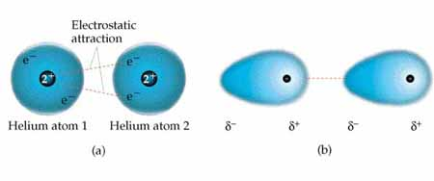
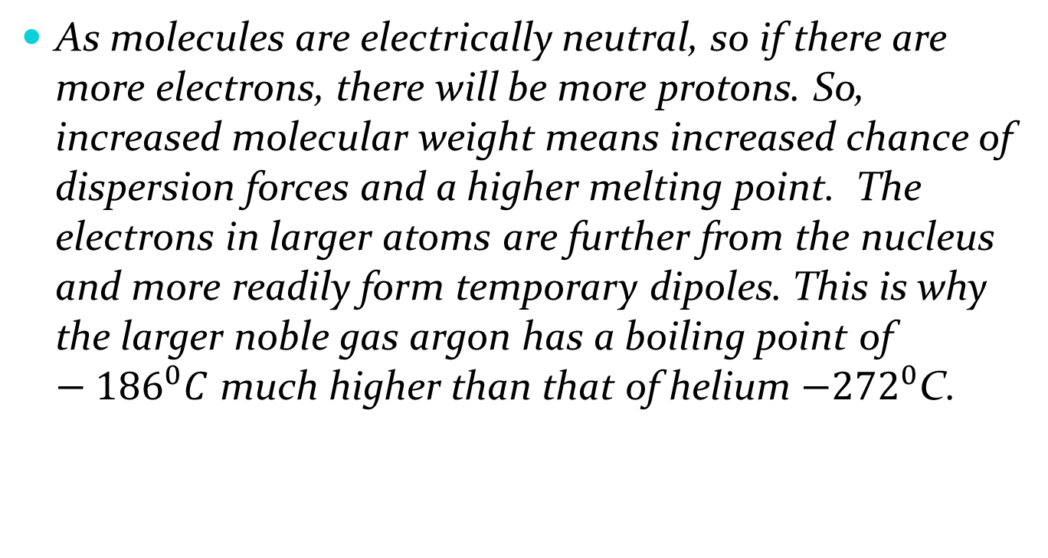
As molecules are electrically neutral, so if there are more electrons, there will be more protons. So, increased molecular weight means increased chance of dispersion forces and a higher melting point. The electrons in larger atoms are further from the nucleus and more readily form temporary dipoles. This is why the larger noble gas argon has a boiling point of $−{186}^{0}C$ much higher than that of helium $−{272}^{0}$C.

Slide 15
Dispersion forces are due to instantaneous temporary dipoles that occur with the movement of electrons. The more electrons present ( the larger the molecular weight), the bigger the dispersion force will be between the molecules.

